Slide 1
Measurement:
Reliability and Validity
Customer Insights Lab
College of Business Administration
Cal Poly Pomona

Slide 2
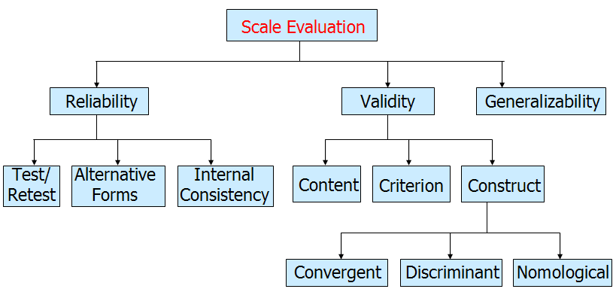


Measurement Accuracy:
Reliability and Validity
X_{O} = X_{T} + X_{S} + X_{R}
X_{O} = the observed score or measurement
X_{T} = the true score of the characteristic
X_{S} = systematic error
X_{R} = random error
Reliability
  X_{O} = X_{T} + X_{S}, where X_{R} = 0, X_{S} = may or may not be zero
  The degree to which measures are free from random error and therefore yield consistent results.
  Repeatability, dependability
  Necessary, but not sufficient condition for validity
  An indicator of a measure’s internal consistency
Validity
  X_{O} = X_{T} , where X_{S} = 0, X_{R} = 0
  Degree to which a measurement instrument accurately measures what it is supposed to measure
  A reliable measure may or may not be valid,
  but a valid measure is reliable
Notes:
Potential Sources of Error on Measurement
Relatively stable characteristics of the individual that influence the test score, such as intelligence, social desirability, and education.
Short-term or transient personal factors, such as health, emotions,
and fatigue.
Situational factors, such as the presence of other people, noise, and distractions.
Sampling of items included in the scale: addition, deletion, or changes in the scale items.
Lack of clarity of the scale, including the instructions or the items themselves.
Mechanical factors, such as poor printing, overcrowding items in the questionnaire, and poor design.
Administration of the scale, such as differences among interviewers.

Slide 3
Relationship Between Reliability and Validity
If a measure is perfectly valid, it is also perfectly reliable. In this case, there is no random or systematic error.
If a measure is unreliable, it cannot be perfectly valid, since at a minimum random error is present. Thus, unreliability implies invalidity.
If a measure is perfectly reliable, it may or may not be perfectly valid, because systematic error may still be present.
Reliability is a necessary, but not sufficient, condition for validity.

Slide 4
Reliability and Validity on Target
Old Rifle New Rifle New Rifle Sun glare
Low Reliability High Reliability Reliable but Not Valid
(Target A) (Target B) (Target C)

Slide 5
Scale Evaluation
Scale
Evaluation
Validity
Reliability
Content
Test-Retest
Internal
Consistency
Criterion
Alternative
Forms
Construct
Convergent
Validity
Discriminant
Validity
Nomological
Validity
Chapter 10 - 5

Slide 6
Reliability
the extent to which measures are free from random error, X_{R}. If X_{R} = 0, the measure is perfectly reliable.
1. Test-retest reliability,
  respondents are administered identical sets of scale items at two different times and the degree of similarity between the two measurements is determined.
2. Alternative-forms reliability,
  two equivalent forms of the scale are constructed and the same respondents are measured at two different times, with a different form being used each time.

Slide 7
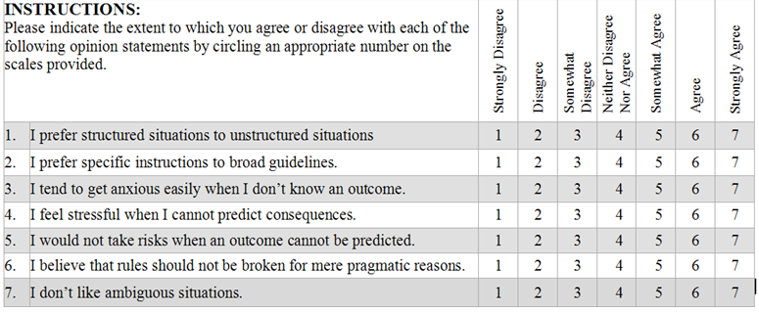
Reliability (cont’d)
3. Internal consistency reliability
determines the extent to which different parts of a summated scale are consistent in what they indicate about the characteristic being measured.
  Split-half reliability,
    the items on the scale are divided into two halves and the resulting half scores are correlated.
  Coefficient alpha, (Cronbach's alpha)
    the average of all possible split-half coefficients resulting from different ways of splitting the scale items.
    This coefficient varies from 0 to 1, and a value of 0.6 or less generally indicates unsatisfactory internal consistency reliability.
Notes:
Internal consistency reliability determines the extent to which different parts of a summated scale are consistent in what they indicate about the characteristic being measured.
In split-half reliability, the items on the scale are divided into two halves and the resulting half scores are correlated.
The coefficient alpha, or Cronbach's alpha, is the average of all possible split-half coefficients resulting from different ways of splitting the scale items. This coefficient varies from 0 to 1, and a value of 0.6 or less generally indicates unsatisfactory internal consistency reliability.

Slide 8
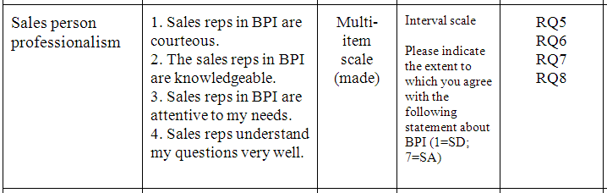
Validity
the extent to which differences in observed scale scores reflect true differences among objects on the characteristic being measured, rather than systematic or random error. Perfect validity requires that there be no measurement error (X_{O} = X_{T} + X_{R} + X_{S ,} where X_{R} = 0, X_{S} = 0).
The extent to which a scale truly reflects the underlying construct that it is supposed to measure.
1. Content validity
The extent to which the content of a measurement scale appears to tap all relevant facets of the construct.
Notes:
The validity of a scale may be defined as the extent to which differences in observed scale scores reflect true differences among objects on the characteristic being measured, rather than systematic or random error. Perfect validity requires that there be no measurement error.
Content validity is a subjective but systematic evaluation of how well the content of a scale represents the measurement task at hand.

Slide 9
Validity (cont’d)
Face Validity
  A scale’s content logically appears to reflect what was intended to be measured.
Content Validity
  The degree that a measure covers the breadth of the domain of interest.

Slide 10
Validity (cont’d)
2. Criterion validity
reflects whether a scale performs as expected in relation to other variables selected (criterion variables) as meaningful criteria.
  Concurrent Validity
    Original instrument and short version are administered simultaneously to the respondents and the results are compared
  Predictive Validity
    Collect data on a scale of interest at one point and collect another data on criteria variable at a future time.
    See if the scale can predict criteria variable in the future
    Ex) At_b of panel member vs. purchase from scanner data
Notes:
Criterion validity reflects whether a scale performs as expected in relation to other variables selected (criterion variables) as meaningful criteria.
Construct validity addresses the question of what construct or characteristic the scale is, in fact, measuring. Construct validity includes convergent, discriminant, and nomological validity.

Slide 11
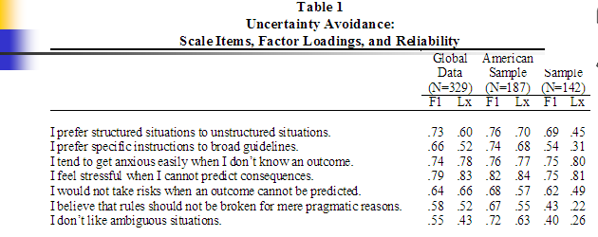
Validity
(cont’d)
3. Construct validity
  Addresses the question of what construct or characteristic the scale is, in fact, measuring.
  Exists when a measure reliably measures and truthfully represents a unique concept.
  Convergent validity is the extent to which the scale correlates positively with other measures of the same construct.
  Discriminant validity is the extent to which a measure does not correlate with other constructs from which it is supposed to differ.
  Nomological validity is the extent to which the scale correlates in theoretically predicted ways with measures of different but related constructs.

Slide 12
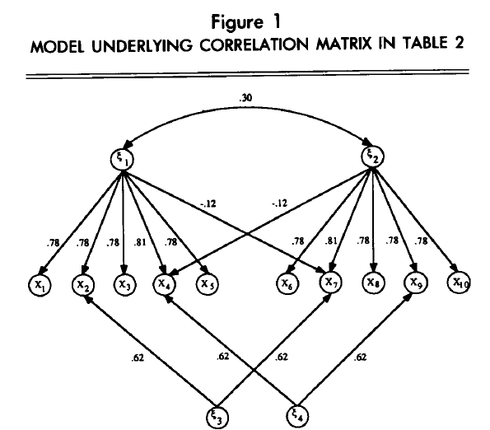
Example of Convergent & Discriminant Validity
Notes:
An Updated Paradigm for Scale Development Incorporating Unidimenstionality and its Assessment
Gerbing, David W.; Anderson, James C.
JMR, Journal of Marketing Research; May 1988; 25, 2

Slide 13
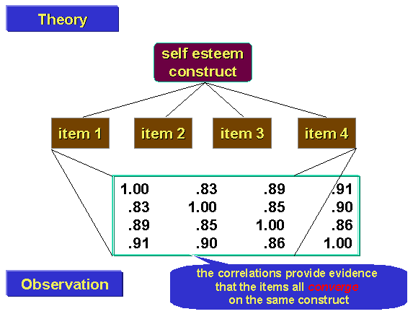
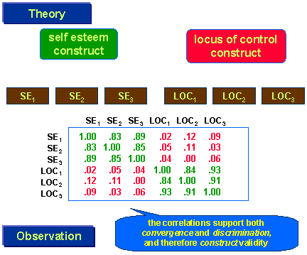
Example of Convergent & Discriminant Validity
http://www.socialresearchmethods.net/kb/convdisc.php

Slide 14
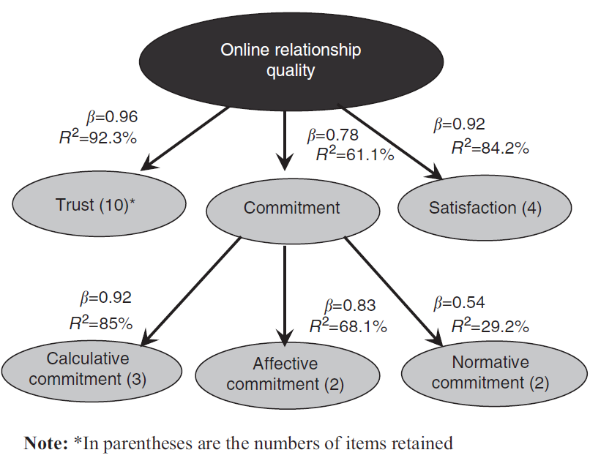

Slide 15
Example: Nomological Validity

Slide 16

Example-Reliability & Validity:
Uncertainty Avoidance Scale

Slide 17
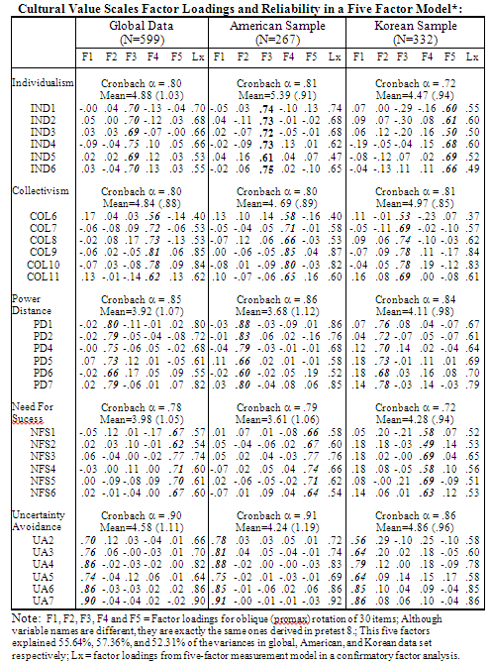

Slide 18
Potential Sources of Error on Measurement
Stable characteristics of the individual that influence the test score, such as intelligence, social desirability, and education.
Short-term or transient personal factors, such as health, emotions,
and fatigue.
Situational factors, such as the presence of other people, noise, and distractions.
Sampling of items included in the scale: addition, deletion, or changes in the scale items.
Lack of clarity of the scale, including the instructions or the items themselves.
Mechanical factors, such as poor printing, overcrowding items in the questionnaire, and poor design.
Administration of the scale, such as differences among interviewers.
Analysis factors, such as differences in scoring and statistical analysis.

